Slide 1
Static Scoping and Name Resolution for Mobile Processes with Polymorphic Interfaces
Matt B. Pedersen & Matthew Sowders
University of Nevada, Las Vegas

Slide 2
What Have we Done?
Added mobile processes to ProcessJ
  With polymorphic interfaces
    Multiple interfaces to the same process
    Different set of formal parameters per interface
mobile void foo (int x, int y) {
...
while (...) {
...
suspend resume with (int z)
...
}
}

Slide 3
Polymorphic Interfaces
mobile void foo (int x, int y) {
...
while (...) {
...
suspend resume with (int z)
...
}
}
foo has 2 interfaces
  (int x, int y)
  (int z)
When foo is started (int x, int y) is used; subsequently (int z) is used.

Slide 4
Why Have we Done That?
MOBILE PROC reindelf (CHAN AGENT.INITIALIZE initialize?,
SHARED CHAN AGENT.MESSAGE report!,
SHARED CHAN INT santa.a!, santa.b!)
IMPLEMENTS AGENT
... local state declarations
SEQ
... in station compound (initialise local state)
WHILE TRUE
SEQ
... in station compound
SUSPEND -- move to gathering place
... in the gathering place
SUSPEND -- move to santa’s grotto
... in santa’s grotto
SUSPEND -- move to compound
:
From: Santa Claus – with mobile reindeer and elves, CPA Fringe presentation 2008

Slide 5
Why Have we Done That?
MOBILE PROC reindelf (CHAN AGENT.INITIALIZE initialize?,
SHARED CHAN AGENT.MESSAGE report!,
SHARED CHAN INT santa.a!, santa.b!)
IMPLEMENTS AGENT
... local state declarations
SEQ
... in station compound (initialise local state)
WHILE TRUE
SEQ
... in station compound
SUSPEND -- move to gathering place
... in the gathering place
SUSPEND -- move to santa’s grotto
... in santa’s grotto
SUSPEND -- move to compound
:
These are all the same interface:
(CHAN AGENT.INITIALIZE initialize?,
SHARED CHAN AGENT.MESSAGE report!,
SHARED CHAN INT santa.a!, santa.b!)

Slide 6
Why Have we Done That?
MOBILE PROC reindelf (CHAN AGENT.INITIALIZE initialize?,
SHARED CHAN AGENT.MESSAGE report!,
SHARED CHAN INT santa.a!, santa.b!)
IMPLEMENTS AGENT
... local state declarations
SEQ
... in station compound (initialise local state)
WHILE TRUE
SEQ
... in station compound
SUSPEND -- move to gathering place
... in the gathering place
SUSPEND -- move to santa’s grotto
... in santa’s grotto
SUSPEND -- move to compound
:
The Initialize channel is only used in
... local state declaration
Subsequent re-animations of reindelf must thus provide ‘dummy’ values for this channel.

Slide 7
Why Have we Done That?
Channel ends (or other parameters) not used in code following a resumption must still be passed
  A dummy reading end passed could cause
  deadlock if ever read.
  Made up actual parameter values must be passed to satisfy the compiler.
Advertisement: Eric and Peter’s Call Channels (Fringe Talk)

Slide 8
Ok, so now what?
What is the semantics of this?
  Parameters do not retain their values between invocations.
  x & y can be referenced in B₁(first invocation);
  z in B₄ (subsequent invocations)
mobile void foo (int x, int y) {
B₁
while (B₂) {
B₃
suspend resume with (int z)
B₄
}
B₅
}

Slide 9
Invocation of Mobiles
mobile void foo (int x, int y) {
B₁
while (B₂) {
B₃
suspend resume with (int z)
B₄
}
B₅
}
Example of execution of foo:
foo(4,5); foo(4), foo(5), foo(7), ….
Only the first time (when foo is started) is the procedure interface used.
All other resumptions use the suspend/resume interface.

Slide 10
Possible Executions
mobile void foo (int x, int y) {
B₁
while (B₂) {
B₃
suspend resume with (int z)
B₄
}
B₅
}
foo(x,y): B₁, B₂, B_{5,} done!
foo(x,y): B₁, B₂, B₃, suspend/foo(z): B₄, B₂, B₅
We see that e.g. B₂ (& B₅) can be executed ‘with’ both x & y as well as z.

Slide 11
Possible Executions
mobile void foo (int x, int y) {
B₁
while (B₂) {
B₃
suspend resume with (int z)
B₄
}
B₅
}
The first time B₂ is executed x seems to be ‘a valid parameter’, but the second time it does not; only z does.

Slide 12
What should we do?
Determine witch parameters can be referenced in all program blocks
  Create a control flow graph (CFG) based on the source
  Massage it a little
  Perform an analysis using In and Out sets (to be defines shortly)

Slide 13
Remember:
The following concerns
parameters only; no
local variables are
considered (yet)

Slide 14
Remember:
Only the parameters
from the most recent
invocation may be
referenced

Slide 15
Initial Control Flow Graph
mobile void foo (int x, int y) {
B₁
while (B₂) {
B₃
suspend resume with (int z)
B₄
}
B₅
}
I0B1
I₀ represents the original
interface:
foo (int x, int y)
I₁ represents the resume
interface:
foo (int z)
B2
B3I1B4
B5

Slide 16
CFG Transformation
B3I1B4
B3
I1
B4
Interfaces are separated out and given
their own nodes

Slide 17
Transformed CFG
mobile void foo (int x, int y) {
B₁
while (B₂) {
B₃
suspend resume with (int z)
B₄
}
B₅
}
I0
B1
B4
B2
I1
B3
B5

Slide 18
CFG with interface information
I0
{(x int I0) (y int I0)}
B1
B4
B2
I1
B3
B5
{(z int I1)}

Slide 19
Interface Nodes
I0
{(x int I0) (y int I0)}
B1
B4
B2
I1
B3
B5
{(z int I1)}

Slide 20
Code Nodes
I0
{(x int I0) (y int I0)}
B1
B4
B2
I1
B3
B5
{(z int I1)}

Slide 21
So Far So Good
Let us define In and Out sets (loosely):
  For interface nodes:
    In Set: Not interesting as an interface defines a new set of parameters
    Out Set: The set of parameters defined by the interface
  For Code nodes:
    In Set: The set of parameters that can be referenced in the node (at least for the final generation of In set)
    Out Set: a copy of the In set

Slide 22
Generation 0 In and Out Sets
Interface Nodes
  In₀(I_{i}) = { }
  Out₀(I_{i}) = {(n_{i,1} t_{i,1} I_{i}) … (n_{i,ki} t_{i,ki} I_{i})}
    The Outset of an interface is the set of
    triples (name type interface) defined by it
Code Nodes
  In₀(B_{j}) = { }
  Out₀(B_{j}) = { }

Slide 23
Example
mobile void foo (int x, int y) {
B₁
while (B₂) {
B₃
suspend resume with (int z)
B₄
}
B₅
}
I₀
For Example
  Out₀(I₀) = { (x int I₀) (y int I₀) }
  Out₀(I₁) = { (z int I₁) }
I₁

Slide 24
In and Out Sets
We generate generations of these sets until no sets change, after which we have the set of parameters that can be referenced for a node in its In set
  We start out with empty sets except for Out sets of interface nodes

Slide 25
CFG with In and Out Sets (Gen. 0)
I0
In(I₀) = { }
Out(I₀) = {(x int I₀) (y int I₀)}
B1
In(B₁) = { }
Out(B₁) = { }
In(B₄) = { }
Out(B₄) = { }
B4
B2
In(B₂) = { }
Out(B₂) = { }
I1
B3
B5
In(B₅) = { }
Out(B₅) = { }
In(I₁) = { }
Out(I₁) = {(z int I₁)}
In(B₃) = { }
Out(B₃) = { }

Slide 26
Generation k+1 (Interface Nodes)
In_{k+1}(I_{i}) = { }
  Interface nodes define a new interface,
  In sets can be ignored.
Out_{k+1}(I_{i}) =
Out_{k}(I_{i}) = {(n_{i,1} t_{i,1} I_{i}) … (n_{i,ki} t_{i,ki} I_{i})}
  Interface nodes always define the same interface.

Slide 27
Generation k+1(Code Nodes)
U
In_{k+1}(B_{j}) = _{(N,Bi)∈ECFG}Out_{k}(N)
  New In set is the intersection of all the Out sets of the code node’s predecessors in the CFG
Out_{k+1}(B_{j}) = In_{k+1}(B_{j})
  The Out set of a code node is the same as its In set, as it cannot define a new interface
  (Technically not needed but nice to have)

Slide 28
Generation k+1(Code Nodes)
U
In_{k+1}(B_{j}) = _{(N,Bi)∈ECFG}Out_{k}(N)
  New In set is the intersection of all the Out sets of the code nodes predecessors in the CFG
Out_{k+1}(B_{j}) = In_{k+1}(B_{j})
  The Out set of a code node is the same as its In set, as it cannot define a new interface
(n_{i} t_{i} I_{i}) == (n_{j} t_{j} I_{i})
<=>
(n_{i} == n_{j}) ∧ (t_{i} == t_{j})

Slide 29
Generation 1 Sets
I0
In(I₀) = { }
Out(I₀) = {(x int I₀) (y int I₀)}
B1
In(B₁) = {(x int I₀) (y int I₀)}
Out(B₁) = {(x int I₀) (y int I₀)}
In(B₄) = { }
Out(B₄) = { }
B4
B2
In(B₂) = { }
Out(B₂) = { }
I1
B3
B5
In(B₅) = { }
Out(B₅) = { }
In(I₁) = { }
Out(I₁) = {(z int I₁)}
In(B₃) = { }
Out(B₃) = { }

Slide 30
Generation 1 Sets
No Changes in B₂ since
In(B₂) = Out(B₁) Out(B₄)
= { } {(x int I₀) (y int I₀)}
I0
In(I₀) = { }
Out(I₀) = {(x int I₀) (y int I₀)}
U
U
B1
In(B₁) = {(x int I₀) (y int I₀)}
Out(B₁) = {(x int I₀) (y int I₀)}
In(B₄) = { }
Out(B₄) = { }
B4
B2
In(B₂) = { }
Out(B₂) = { }
I1
B3
B5
In(B₅) = { }
Out(B₅) = { }
In(I₁) = { }
Out(I₁) = {(z int I₁)}
In(B₃) = { }
Out(B₃) = { }

Slide 31
Generation 1 Sets
I0
In(I₀) = { }
Out(I₀) = {(x int I₀) (y int I₀)}
B1
In(B₁) = {(x int I₀) (y int I₀)}
Out(B₁) = {(x int I₀) (y int I₀)}
In(B₄) = { }
Out(B₄) = { }
B4
B2
In(B₂) = { }
Out(B₂) = { }
I1
B3
B5
In(B₅) = { }
Out(B₅) = { }
In(I₁) = { }
Out(I₁) = {(z int I₁)}
In(B₃) = { }
Out(B₃) = { }

Slide 32
Generation 1 Sets
I0
In(I₀) = { }
Out(I₀) = {(x int I₀) (y int I₀)}
B1
In(B₁) = {(x int I₀) (y int I₀)}
Out(B₁) = {(x int I₀) (y int I₀)}
In(B₄) = {(z int I₁)}
Out(B₄) = {(z int I₁)}
B4
B2
In(B₂) = { }
Out(B₂) = { }
I1
B3
B5
In(B₅) = { }
Out(B₅) = { }
In(I₁) = { }
Out(I₁) = {(z int I₁)}
In(B₃) = { }
Out(B₃) = { }

Slide 33
Generation 1 Sets
I0
In(I₀) = { }
Out(I₀) = {(x int I₀) (y int I₀)}
B1
In(B₁) = {(x int I₀) (y int I₀)}
Out(B₁) = {(x int I₀) (y int I₀)}
In(B₄) = {(z int I₁)}
Out(B₄) = {(z int I₁)}
B4
B2
In(B₂) = { }
Out(B₂) = { }
I1
B3
B5
In(B₅) = { }
Out(B₅) = { }
In(I₁) = { }
Out(I₁) = {(z int I₁)}
In(B₃) = { }
Out(B₃) = { }

Slide 34
In & Out Sets after Generation 1
I0
In(I₀) = { }
Out(I₀) = {(x int I₀) (y int I₀)}
B1
In(B₁) = {(x int I₀) (y int I₀)}
Out(B₁) = {(x int I₀) (y int I₀)}
In(B₄) = {(z int I₁)}
Out(B₄) = {(z int I₁)}
B4
B2
In(B₂) = { }
Out(B₂) = { }
I1
B3
B5
In(B₅) = { }
Out(B₅) = { }
In(I₁) = { }
Out(I₁) = {(z int I₁)}
In(B₃) = { }
Out(B₃) = { }

Slide 35
Generation 2 In and Out Sets
Nothing changes when computing generation 2.

Slide 36
Final In and Out Sets
I0
In(I₀) = { }
Out(I₀) = {(x int I₀) (y int I₀)}
B1
In(B₁) = {(x int I₀) (y int I₀)}
Out(B₁) = {(x int I₀) (y int I₀)}
In(B₄) = {(z int I₁)}
Out(B₄) = {(z int I₁)}
B4
B2
In(B₂) = { }
Out(B₂) = { }
I1
B3
B5
In(B₅) = { }
Out(B₅) = { }
In(I₁) = { }
Out(I₁) = {(z int I₁)}
In(B₃) = { }
Out(B₃) = { }

Slide 37
Final Result of Analysis
I0
B1
{ x, y }
{ z }
{ }
B4
B2
I1
B3
{ }
B5
{ }

Slide 38
Final Result of Analysis
During all possible executions we can only guarantee that
  x and y are always available in B₁
  z is always available in B₄

Slide 39
Name Resolution
We have not considered local variables or how to resolve name usage in the code
  For locals, regular scoping rules apply
  Locals can hide parameters
  One symbol table for an interface
  One symbol table for its body

Slide 40
Name Resolution
A suspend/resume point acts like the procedure interface
  One symbol table for the interface
  One symbol table for the implicit ‘body’ following
    End of scope determined by the closest enclosing scope of the suspend/resume statement.
A block { } and a for-statement opens a new scope as well

Slide 41
Now with Locals ;-)
mobile void foo (int x, int y)
{
int a;
B₁
while (B₂)
{
int q;
B₃
suspend resume with (int z)
int w,z;
B₄
} Implicit end of scopes opened by suspend
B₅
}

Slide 42
Now with Locals And Scopes
mobile void foo
{^{+T0}
(int x, int y)
{^{+T1}
int a;
B₁
while (B₂)
{^{+T2}
int q;
B₃
suspend resume with
{^{+T3}
(int z)
{^{+T4}
int w,z;
B4
}^{-T4}
}^{-T3}
}^{-T2}
B5
}^{-T1}
}^{-T0}
Implicit scopes added in red
Parameter scope for
procedure interface (T₀)
Parameter scope for
suspend/resume interface
(T₃)
Body scope for
suspend/resume interface
(T₄)

Slide 43
Name Resolution
A symbol Table now has an ‘access list’
  Only name-uses in code blocks listed in the access list are allowed to perform a look up in the table – if not listed, move on to the parent table.
Name | Value
int | z
Access List: {1,2,3,4,5}
Parent
Table

Slide 44
Symbol Tables
Only symbol tables associated with the implicit scopes of interfaces have limited access lists; all others have full access
Table for T₀
foo (int x, int y)
Table for T₃
suspend resume with (int z)
Name | Value
int | x
int | y
Access List: { 1 }
Name | Value
int | z
Access List: { 4 }

Slide 45
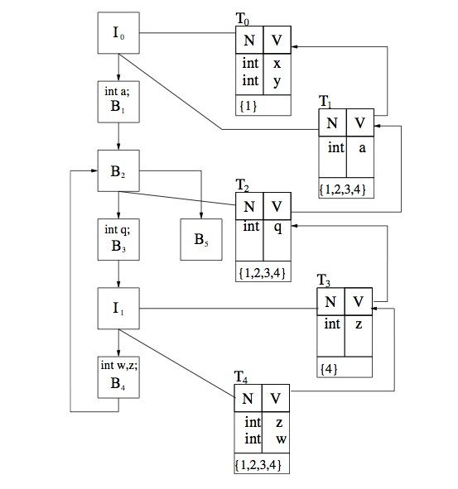
Errata: Access lists of T₁, T₂ & T₄
in the paper are incorrect.
They read {1,2,3,4} they should
be {1,2,3,4,5}
(the 5 has gone missing}
{1,2,3,4,5}
{1,2,3,4,5}
{1,2,3,4,5}

Slide 46
I₀
B₁
B₂
B₃
B₅
I₁
B₄

Slide 47
T₀
N | V
int | x
int | y
{ 1 }
I₀
B₁
B₂
The access list contains only 1,
because x and y can only be
referenced in B₁.
B₃
B₅
I₁
B₄

Slide 48
T₀
N | V
int | x
int | y
{ 1 }
T₁
N | V
int | a
{ 1, 2, 3, 4, 5 }
I₀
B₁
B₂
B₃
B₅
I₁
B₄

Slide 49
T₀
N | V
int | x
int | y
{ 1 }
T₁
N | V
int | a
{ 1, 2, 3, 4, 5 }
I₀
B₁
T₂
B₂
N | V
int | q
{ 1, 2, 3, 4, 5 }
B₃
B₅
I₁
B₄

Slide 50
T₀
N | V
int | x
int | y
{ 1 }
T₁
N | V
int | a
{ 1, 2, 3, 4, 5 }
I₀
B₁
T₂
B₂
N | V
int | q
{ 1, 2, 3, 4, 5 }
B₃
B₅
T₃
N | V
int | z
{ 4 }
I₁
z from I₁ can only be
referenced in B₄
B₄

Slide 51
T₀
N | V
int | x
int | y
{ 1 }
T₁
N | V
int | a
{ 1, 2, 3, 4, 5 }
I₀
B₁
T₂
B₂
N | V
int | q
{ 1, 2, 3, 4, 5 }
B₃
B₅
T₃
N | V
int | z
{ 4 }
I₁
T₄
N | V
int | w
int | z
{ 1, 2, 3, 4, 5 }
B₄

Slide 52
Red arrows indicate
in which table
resolution starts
T₀
N | V
int | x
int | y
{ 1 }
T₁
N | V
int | a
{ 1, 2, 3, 4, 5 }
I₀
B₁
T₂
B₂
N | V
int | q
{ 1, 2, 3, 4, 5 }
B₃
B₅
T₃
N | V
int | z
{ 4 }
I₁
T₄
N | V
int | w
int | z
{ 1, 2, 3, 4, 5 }
B₄

Slide 53
Final Results
We get the following table of blocks and which parameters and locals they can reference.
Block | Locals | Parameter
B₁ | a ∈T₁ | x ∈ T₀, y∈ T₀
B₂ | a ∈ T₁
B₃ | q ∈ T₂, a ∈ T₁
B₄ | w ∈ T₄, z ∈ T₄, q ∈ T₂, a ∈ T₁ | z ∈ T₃
B₅ | a ∈ T₁
Errata: Table 4 Parameter for B4 should read z ∈ T₃ and not z ∈ T₄

Slide 54
Conclusion
We have defined and implemented mobile procedures with polymorphic interfaces in ProcessJ
Provided a new scope resolution mechanism for polymorphic mobiles that performs correct name resolution

Slide 55
Conclusion
Provided an implementation in Java/JCSP (ProcessJ translated to Java with JCSP)
  Paper on the implementation (similar to our 2009 paper at CPA but without byte code rewriting) is being presented at PDPTA 2011 in July.
processj.cs.unlv.edu (currently turned off cause of hackers but we will be back up soon)

Slide 56

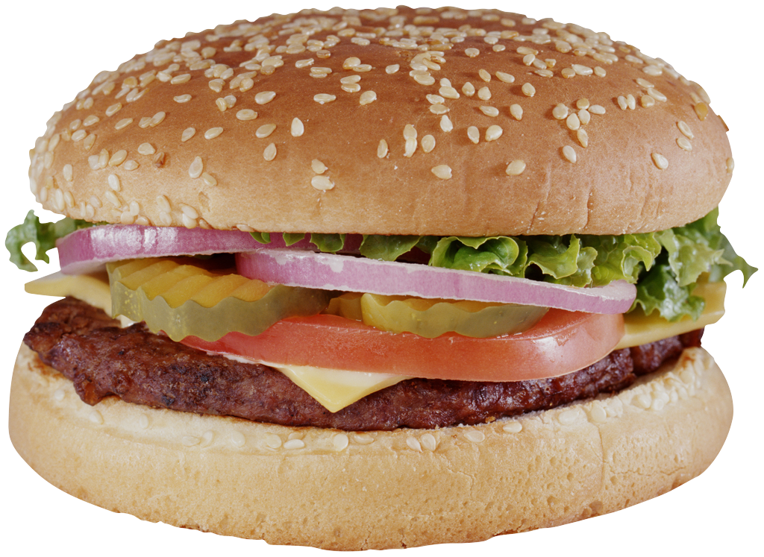
Questions
or
Lunch?

