Slide 1
ProcessJ: A Possible Future of Process-Oriented Design
Jan Bækgaard Pedersen (UNLV)
Marc L. Smith (Vassar)
CPA-2013
25-28 August 2013

Slide 2
What do we have to do ….
Question: What do we have to do to
spread the word about/use of process oriented design?
make the experience more easily accessible?
convince the distributed programming community that it actually is a good idea?
(This might include hostage taking)
Show that it can actually be used for HPC?

Slide 3
What do we have to do ….
Answer:
Easy to learn language with the right semantics
Syntax of a familiar language (business as usual)
Safer semantics (but you can’t do those bad things!)
Incorporation into online teaching tools
Accessible from anywhere
Easy to use in classrooms and teaching settings
Educational material
Finally someone will write “the book” (Peter?!)
Supporting course material (videos, …)

Slide 4
IDE/GUI
Process
repo.
Legends
A B
Prog.
language
Compiler
Runtime
Cloud
storage
B uses A
Technical
A B
A makes B
A B
Executable
CSP
scripts
FDR verifier
B is based on A
Web tool
(teaching)
New parts
Existing tools
Educational
Learning
material
Course
templates
Slides
Notes
Books
Lecture
material
Videos

Slide 5
IDE/GUI
Process
repo.
Legends
A B
Prog.
language
Compiler
Runtime
Cloud
storage
B uses A
Technical
A B
A makes B
A B
Executable
CSP
scripts
What should these be?
B is based on A
FDR verifier
Web tool
(teaching)
New parts
Existing tools
Educational
Learning
material
Course
templates
Slides
Notes
Books
Lecture
material
Videos

Slide 6
New Language (again)
Why not just provide a library for C/Java?
C: Too general – let you do bad things on purpose
Pointers
Shared memory
…
Java/JVM: Threading model of runtime too coarse
Speed?
Those pesky objects with wait and notify….
If the programmer does not promise to behave 100% things will definitely go wrong.
Programmer must stick to the “CSP Model”

Slide 7
New Language (again)
Perhaps a new syntax with a pre-processor and a source to source translator
A possibility – with some checking
New language might more easily achieve and incorporate what we want
Integration of CSP generation
Might require a separate parser anyway

Slide 8
New Language (again)
New language with the whole package (and more)
“known” syntax (like Java-ish)
Has communication primitives with CSP semantics
Synchronous channel communication
Barriers
Alternations
Parallel composition
Mobility (pi-calculus)
Has C/Java semantics for all other sequential language constructs
Has no shared memory abilities/pointers
Fast runtime system with multi-core scheduler

Slide 9
IDE/GUI
Process
repo.
Legends
A B
ProcessJ
language
ProcessJ
compiler
Runtime
(ccsp)
Cloud
storage
B uses A
Technical
A B
A makes B
A B
Executable
CSP
scripts
FDR verifier
B is based on A
Web tool
(teaching)
New parts
Existing tools
Educational
Learning
material
Course
templates
Slides
Notes
Books
Lecture
material
Videos

Slide 10
IDE/GUI
Process
repo.
ProcessJ
language
ProcessJ
compiler
Runtime
(ccsp)
Cloud
storage
Technical
Executable
CSP
scripts
FDR verifier
Web tool
(teaching)
Educational
Learning
material
Course
templates
Slides
Notes
Books
Lecture
material
Videos

Slide 11
Education is Everything
Process-Oriented Design
We must teach it…
…if we want students to learn it
The longer we wait
The harder it is to teach
The harder it is to learn
The longer we wait
The less natural it feels
The lower our chance of success

Slide 12
Language is Everything
Forget about ProcessJ for a moment… and programming languages
Programming languages Natural languages
The language we speak shapes our thoughts
Teach foreign languages too late children unlikely to become multilingual

Slide 13
Programming Language is Everything
The language we learn to program in shapes how we solve problems
Teach concurrent languages too late students unlikely to become parallel programmers
We may say we care more about concurrency and process-oriented design more than any language…
…but without an accessible process-oriented language, concurrency remains inaccessible

Slide 14
The Wrong Debate(s)!
The CS Education community has been debating the wrong things:
FP vs OOP ?
Objects first vs Objects early vs Objects later vs Objects late ?
What about: Sequential vs Concurrent ?
The debate that hasn’t happened (yet!)
Institutional bias toward sequential!
We teach it like we learned it

Slide 15
Race[condition]ism!
Conventional wisdom:
Concurrency is hard!
Hard to write (from an ingrained sequential mindset)
Hard to test (too many possible interleavings!)
Hard to debug (Heisenbugs)
In short: Hard to reason about!
Conventional Wisdom is wrong!
CW applies to particular models of concurrency
Thread s and Locks with shared memory
Asynchronous message passing

Slide 16
Special Sequential Interests
Compositional blind spot!
Sequential composition (in Java or your favorite OOL)
Data composes (i.e., data structures)
Code composes (i.e., code blocks)
Data and Methods compose (i.e., classes)
Classes compose (i.e., packages/libraries)
Packages compose (i.e., frameworks)
Concurrent Composition?
Threads don’t compose group of threads
Asynchronous message passing larger collection of objects and message buffers

Slide 17
Process-Oriented Abstraction is Everything
Compositional / Concurrency Abstraction
Processes compose explicitly:
Sequentially
Parallel
Choice (alternation)
The composition of two or more processes is a process! (which can in turn be further composed)
Reason about processes at an appropriate level of abstraction (internal hiding)

Slide 18
Process-Oriented Design Makes All the Difference
Lowest level processes are sequential CSP, after all, stands for Communicating Sequential Processes
Parallel composition is just another choice for composition, alongside sequential (;) composition!
With the right language and syntax, Process-Oriented design could be taught: First? Early? Later? Late?
The earlier the better—let’s not debate this!

Slide 19
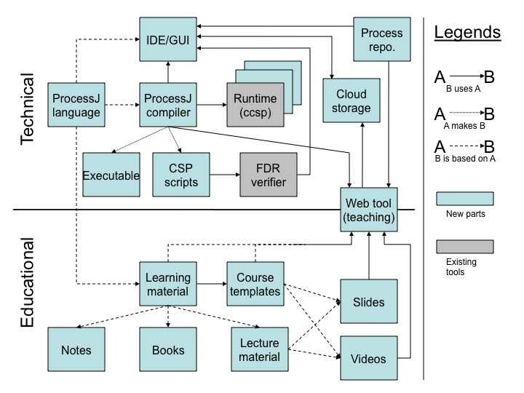
ProcessJ is Everything

Slide 20
Timing is Everything
ACM/IEEE-CS Joint Task Force for Computing Curricula. Computer Science Curricula 2013, Ironman Draft
includes for the first time Parallel Programming in the Core [undergraduate] Curriculum
new Knowledge Area (KA): Parallel and Distributed Computing
Concurrency is no longer an elective topic!

Slide 21
Context is Everything (from the Ironman draft)
“Parallel computing: Among the many changes to the Body of Knowledge compared to previous reports is a new Knowledge Area in Parallel and Distributed Computing. An alternative structure for the Body of Knowledge would place relevant topics in other Knowledge Areas: parallel algorithms with algorithms, programming constructs in software-development focused areas, multi-core design with computer architecture, and so forth. We chose instead to provide guidance on the essential parallelism topics in one place. Some, but not all, curricula will likely have courses dedicated to parallelism, at least in the near term.”

Slide 22
From a Research Perspective
^{NSF Call for Proposals:}
“New programming languages and language mechanisms that support new computational models, raise the level of abstraction, and lower the barrier of entry for parallel and concurrent programming. Parallel and concurrent languages that have programmability, verifiability, and scalable performance as design goals. Of particular interest are languages that abstract away from the traditional imperative programming model found in most sequential programming languages.”

Slide 23
IDE/GUI
Process
repo.
ProcessJ
language
ProcessJ
compiler
Runtime
(ccsp)
Cloud
storage
Technical
Executable
CSP
scripts
FDR verifier
Web tool
(teaching)
Educational
Learning
material
Course
templates
Slides
Notes
Books
Lecture
material
Videos

Slide 24
Support is Everything
We must help make it easier for faculty to consider adopting Process-Oriented Design in their courses
The Web Tool will be the portal to supporting materials, including
Learning material: notes, book(s), lectures
Course templates
Slides and videos

Slide 25
IDE/GUI
Process
repo.
ProcessJ
language
ProcessJ
compiler
Runtime
(ccsp)
Cloud
storage
Technical
Executable
CSP
scripts
FDR verifier
Web tool
(teaching)
Educational
Learning
material
Course
templates
Slides
Notes
Books
Lecture
material
Videos

Slide 26
ProcessJ Language
ProcessJ has Java-like syntax
Without objects
With records and arrays
CSP primitives:
Synchronous channels
Alternation
Barriers
Protocols
….
All the good stuff we know from occam

Slide 27
ProcessJ Language
Java like statements for while, do, for etc.
with Java/C semantics
Channel communication, alternation etc.
with CSP semantics
Process Mobility
pi-calculus
Polymorphic resumption interfaces

Slide 28
ProcessJ Example
proc void Producer (chan<int>.write out) { ^{int x = 42;} ^{while (true) {} ^{while (x < 1000) {} ^{out.write (x);} ^{x++;} } ^{while (x > 0) {} ^{out.write (x);} ^{x--;} } }

Slide 29
ProcessJ Example
proc void Producer (chan<int>.write out) { ^{int x = 42;} ^{while (true) {} ^{while (x < 1000) {} ^{out.write (x);} ^{x++;} } ^{while (x > 0) {} ^{out.write (x);} ^{x--;} } }
Writing end of a channel
carrying integers;
named out.

Slide 30
ProcessJ Example
proc void Producer (chan<int>.write out) { ^{int x = 42;} ^{while (true) {} ^{while (x < 1000) {} ^{out.write (x);} ^{x++;} } ^{while (x > 0) {} ^{out.write (x);} ^{x--;} } }
Write the value of x to
the channel out.

Slide 31
ProcessJ Example
proc void Producer (chan<int>.write out) { ^{int x = 42;} ^{while (true) {} ^{while (x < 1000) {} ^{out.write (x);} ^{x++;} } ^{while (x > 0) {} ^{out.write (x);} ^{x--;} } }

Slide 32
ProcessJ Example
proc void Monitor (chan<int>.read in) {
^{int last = in.read ();}
^{while (true) {}
^{int x;}
^{x = in.read ();}
^{if (x == last) {}
^{... system failure detected}
}
^{last = x;}
}
}

Slide 33
ProcessJ Example
proc void Monitor (chan<int>.read in) {
^{int last = in.read ();}
^{while (true) {}
^{int x;}
^{x = in.read ();}
^{if (x == last) {}
^{... system failure detected}
}
^{last = x;}
}
}
Reading end of a channel
carrying integers;
named in.

Slide 34
ProcessJ Example
proc void Monitor (chan<int>.read in) {
^{int last = in.read ();}
^{while (true) {}
^{int x;}
^{x = in.read ();}
^{if (x == last) {}
^{... system failure detected}
}
^{last = x;}
}
}
Reading from the
channel named in

Slide 35
ProcessJ Example
proc void Monitor (chan<int>.read in) {
^{int last = in.read ();}
^{while (true) {}
^{int x;}
^{x = in.read ();}
^{if (x == last) {}
^{... system failure detected}
}
^{last = x;}
}
}

Slide 36
ProcessJ Example
^{proc void main() {}
^{chan<int> c;}
^{par {}
^{Producer (c.write);}
^{Monitor (c.read);}
}
}

Slide 37
ProcessJ Example
^{proc void main() {}
^{chan<int> c;}
^{par {}
^{Producer (c.write);}
^{Monitor (c.read);}
}
}
Declare a channel
carrying integers

Slide 38
ProcessJ Example
^{proc void main() {}
^{chan<int> c;}
^{par {}
^{Producer (c.write);}
^{Monitor (c.read);}
}
}
In parallel run
Producer and
Monitor

Slide 39
ProcessJ Example
^{proc void main() {}
^{chan<int> c;}
^{par {}
^{Producer (c.write);}
^{Monitor (c.read);}
}
}

Slide 40
ProcessJ Example
proc void Producer (chan<int>.write out) { ^{int x = 42;} ^{while (true) {} ^{while (x < 1000) {} ^{out.write (x);} ^{x++;} } ^{while (x > 0) {} ^{out.write (x);} ^{x--;} } }
proc void Monitor (chan<int>.read in) {
^{int last = in.read ();}
^{while (true) {}
^{int x;}
^{x = in.read ();}
^{if (x == last) {}
^{... system failure detected}
}
^{last = x;}
}
}
^{proc void main() {}
^{chan<int> c;}
^{par {}
^{Producer (c.write);}
^{Monitor (c.read);}
}
}

Slide 41
IDE/GUI
Process
repo.
ProcessJ
language
ProcessJ
compiler
Runtime
(ccsp)
Cloud
storage
Technical
Executable
CSP
scripts
FDR verifier
Web tool
(teaching)
Educational
Learning
material
Course
templates
Slides
Notes
Books
Lecture
material
Videos

Slide 42
ProcessJ Compiler
New compiler written in C/C++ using the CCSP runtime.
Other back ends:
JavaScript for online teaching tool
MPI
Generates CSP-M for FDR 3 ( ;-) ) checking

Slide 43
IDE/GUI
Process
repo.
ProcessJ
language
ProcessJ
compiler
Runtime
(ccsp)
Cloud
storage
Technical
Executable
CSP
scripts
FDR verifier
Web tool
(teaching)
Learning
material
Course
templates
Educational
Slides
Notes
Books
Lecture
material
Videos

Slide 44
GUI for ProcessJ
Process oriented programming is well suited for graphical programming
Processes are nodes
Channels are arcs
Processes can consist of other processes which can consist of other processes etc.
Processes are building blocks for other processes
We have a “Lego” catalogue of well known processes
Code reuse is as easy as drag and drop (and connect external channels)

Slide 45
GUI for ProcessJ
GUI should integrate into
Process repository
Online Cloud Storage
GUI should produce CSP based on process layout
And perhaps also documentation
Visual occam is a graphical programming interface (M.Sc. Thesis project) – proof of concept.
Works for occam
Written in Java

Slide 46
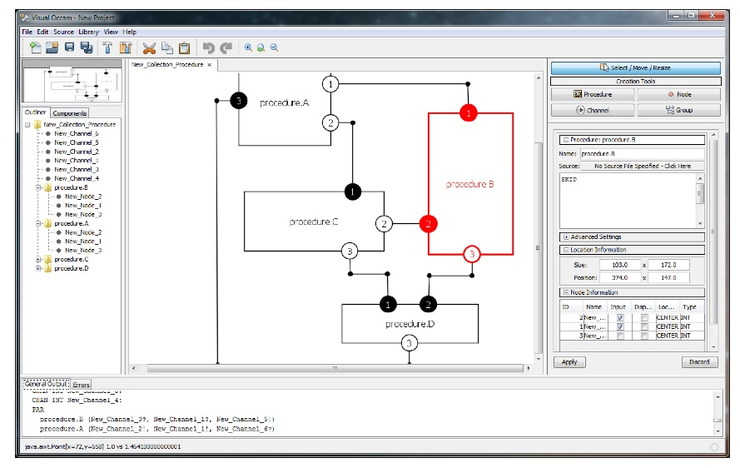
GUI – Visual occam

Slide 47
IDE/GUI
Process
repo.
ProcessJ
language
ProcessJ
compiler
Runtime
(ccsp)
Cloud
storage
Technical
Executable
CSP
scripts
FDR verifier
Web tool
(teaching)
Learning
material
Course
templates
Educational
Slides
Notes
Books
Lecture
material
Videos

Slide 48
ProcessJ Process Repository
Like the Apple App Store, but with source
Free ;-)
For developers/programmers
ProcessJ code can be shared
Annotated with CSP assertions certificate
Deadlock free, livelock free, ..
Programmer generated assertions
Example code for use can be associated

Slide 49
IDE/GUI
Process
repo.
ProcessJ
language
ProcessJ
compiler
Runtime
(ccsp)
Cloud
storage
Technical
Executable
CSP
scripts
FDR verifier
Web tool
(teaching)
Educational
Learning
material
Course
templates
Slides
Notes
Books
Lecture
material
Videos

Slide 50
Cloud Storage
Online storage of ProcessJ code / CSP
Accessible through
Web interface (ProcessJ website)
GUI
Online Teaching Tool
Integrating well known storage sites like
GitHub
Google Drive
Dropbox

Slide 51
IDE/GUI
Process
repo.
ProcessJ
language
ProcessJ
compiler
Runtime
(ccsp)
Cloud
storage
Technical
Executable
CSP
scripts
FDR verifier
Web tool
(teaching)
Educational
Learning
material
Course
templates
Slides
Notes
Books
Lecture
material
Videos

Slide 52
ProcessJ Online Teaching Tool
Web tool (massive open online course)
Written in HTML 5
Contains
ProcessJ editor
Cloud Storage access
Process Repository access
Compilation done remotely – execution done locally
Remote compiler returns JavaScript and a JavaScript CSP runtime.
Integrates teaching materials
Notes, videos, etc (like codingbat etc.)

Slide 53
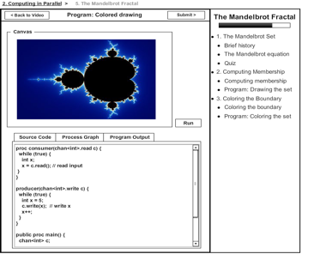
ProcessJ Online Teaching Tool

Slide 54
Aliasing Issues
Data structures for creating graphs etc are important
If you can’t do what you normally do in the language no one wants it!
Parallel usage checking might be hard (impossible) to do at compile time
Maybe offer runtime checking (expensive, but if you want all the bells and whistles, it will cost you!)
????

Slide 55
Us and Them (The Environment)
Paper arose from an NSF proposal (that did not get funded) seeking
“New programming languages and language mechanisms that support new computational models, raise the level of abstraction, and lower the barrier of entry for parallel and concurrent programming. Parallel and concurrent languages that have programmability, verifiability, and scalable performance as design goals. Of particular interest are languages that abstract away from the traditional imperative programming model found in most sequential programming languages.”
Some of the comments might give an insight into what ‘they’ think
Shows us what the computing community thinks about process oriented design
Might help us devise different strategies

Slide 56
Us and Them (The Environment)
“At times, the proposal is talking about CSP as a panacea. Unfortunately, this (in my opinion) reveals ignorance of the richness of both the problem space (types of applications) and the solution space (known models for parallel or concurrent computation), and thus undermines the credibility of success. For example, try writing a well-performing parallel matrix multiplication in CSP.”

Slide 57
Us and Them (The Environment)
Matrix multiplication: for (i=0 ; i<n; i++) { for (j=0; j<n; j++) { C[i][j] = 0; for (k=0; k<n; k++) { C[i][j] += A[i][j]*B[j][k]; } } }

Slide 58
Us and Them (The Environment)
ProcessJ parallel matrix multiplication: par for (i=0 ; i<n; i++) { par for (j=0; j<n; j++) { C[i][j] = 0; for (k=0; k<n; k++) { C[i][j] += A[i][j]*B[j][k]; } } }
Or a systolic array of n*n processes

Slide 59
Us and Them (The Environment)
“The inclusion of a graphical interface / IDE is a nice idea, but orthogonal as a research problem.
“Graphical IDEs have been around forever, but have never made it beyond the fringe. They tend to survive only if supported by a monopolistic proprietary owner.”
This shows a lack of understanding of the power of programming-by-picture and the importance of composability.
Learning curve cannot be too high (for the GUI)
Used in VLSI for decades!

Slide 60
Us and Them (The Environment)
“Can’t you just use Google’s Go?”

Slide 61

Us and Them (The Environment)
“Can’t you just use Google’s Go?”

Slide 62

Talk amongst yourselves; I’ll give you a topic:
“The future of Process Oriented Programming”
Discuss!!!

