Slide 1
ProcessJ: A Possible Future of Process-Oriented Design
Jan Bækgaard Pedersen (UNLV)
Marc L. Smith (Vassar)
CPA-2013
25-28 August 2013

Slide 2
Education is Everything
Process-Oriented Design
  We must teach it…
  …if we want students to learn it
The longer we wait
  The harder it is to teach
  The harder it is to learn
The longer we wait
  The less natural it feels
  The lower our chance of success

Slide 3
Language is Everything
Forget about ProcessJ for a moment…
and programming languages
Programming languages Natural languages
The language we speak shapes our thoughts
Teach foreign languages too late
children unlikely to become multilingual

Slide 4
Programming Language is Everything
The language we learn to program in shapes how we solve problems
Teach concurrent languages too late
students unlikely to become parallel programmers
We may say we care more about concurrency and process-oriented design more than any language…
…but without an accessible process-oriented language, concurrency remains inaccessible

Slide 5
The Wrong Debate(s)!
The CS Education community has been debating the wrong things:
  FP vs OOP ?
  Objects first vs Objects early vs Objects later vs Objects late ?
What about: Sequential vs Concurrent ?
  The debate that hasn’t happened (yet!)
  Institutional bias toward sequential!
  We teach it like we learned it

Slide 6
Race[condition]ism!
Conventional wisdom:
  Concurrency is hard!
    Hard to write (from an ingrained sequential mindset)
    Hard to test (too many possible interleavings!)
    Hard to debug (Heisenbugs)
  In short: Hard to reason about!
Conventional Wisdom is wrong!
CW applies to particular models of concurrency
    Thread s and Locks with shared memory
    Asynchronous message passing

Slide 7
Special Sequential Interests
Compositional blind spot!
Sequential composition (in Java or your favorite OOL)
  Data composes (i.e., data structures)
  Code composes (i.e., code blocks)
  Data and Methods compose (i.e., classes)
  Classes compose (i.e., packages/libraries)
  Packages compose (i.e., frameworks)
Concurrent Composition?
  Threads don’t compose group of threads
  Asynchronous message passing larger collection of objects and message buffers

Slide 8
Process-Oriented Abstraction is Everything
Compositional / Concurrency Abstraction
Processes compose explicitly:
  Sequentially
  Parallel
  Choice (alternation)
The composition of two or more processes is a process! (which can in turn be further composed)
Reason about processes at an appropriate level of abstraction (internal hiding)

Slide 9
Process-Oriented Design Makes All the Difference
Lowest level processes are sequential
CSP, after all, stands for
Communicating Sequential Processes
Parallel composition is just another choice for composition, alongside sequential (;) composition!
With the right language and syntax, Process-Oriented design could be taught:
First?
Early?
Later?
Late?
The earlier the better—let’s not debate this!

Slide 10
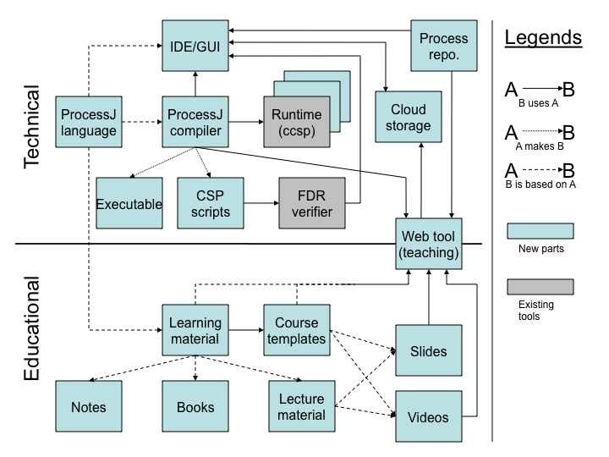
ProcessJ is Everything

Slide 11
Timing is Everything
ACM/IEEE-CS Joint Task Force for Computing Curricula. Computer Science Curricula 2013, Ironman Draft
  includes for the first time Parallel Programming in the Core [undergraduate] Curriculum
  new Knowledge Area (KA): Parallel and Distributed Computing
  Concurrency is no longer an elective topic!

Slide 12
Context is Everything
(from the Ironman draft)
“Parallel computing: Among the many changes to the Body of Knowledge compared to previous reports is a new Knowledge Area in Parallel and Distributed Computing. An alternative structure for the Body of Knowledge would place relevant topics in other Knowledge Areas: parallel algorithms with algorithms, programming constructs in software-development focused areas, multi-core design with computer architecture, and so forth. We chose instead to provide guidance on the essential parallelism topics in one place. Some, but not all, curricula will likely have courses dedicated to parallelism, at least in the near term.”

Slide 13
IDE/GUI
Process
repo.
ProcessJ
language
ProcessJ
compiler
Runtime
(ccsp)
Cloud
storage
Technical
Executable
CSP
scripts
FDR
verifier
Web tool
(teaching)
Educational
Learning
material
Course
templates
Slides
Notes
Books
Lecture
material
Videos

Slide 14
Support is Everything
We must help make it easier for faculty to consider adopting Process-Oriented Design in their courses
The Web Tool will be the portal to supporting materials, including
  Learning material: notes, book(s), lectures
  Course templates
  Slides and videos

