Slide 1

^{JVMCSP}
Approaching Billions of Processes on a Single-Core JVM
Cabel Shrestha & Matt B. Pedersen

Slide 2

Last Time … (CPA 2014)
We presented
ProcessJ (Process-Oriented Language)
Handcrafted JVM runtime: LiteProc (proof of concept)
~ 95,000,000 concurrent processes

Slide 3
This Time … (CPA 2016)
An implemented code generator in ProcessJ
New improved runtime
Faster
Handles more processes

Slide 4
From ProcessJ to Java Bytecode
ProcessJ compiler produces Java source code.
Compiled with Javac.
Instrumented with ASM byte code manipulation tool.
Jar’d together with runtime

Slide 5
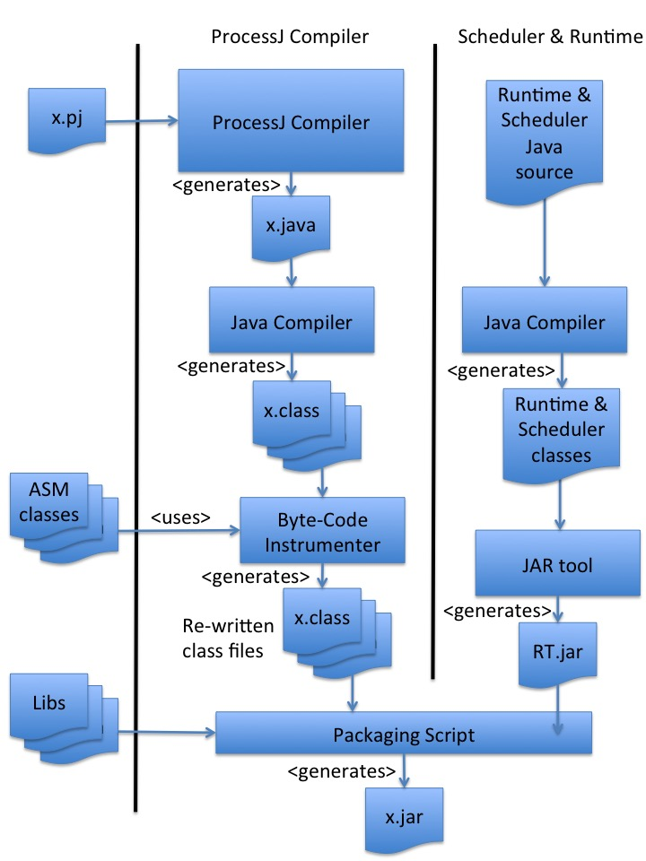

Slide 6
Runtime (Scheduler)
User-level scheduler
Cooperative, non-preemptive.
^{Queue<Process> processQueue;}
...
// enqueue one or more processes to run
while (!processQueue.isEmpty()) {
Process p = processQueue.dequeue();
^{if (p.ready())}
^{p.run();}
^{if (!p.terminated())}
^{processQueue.enqueue(p);}
}

Slide 7
Essential Questions
How does a procedure yield?
When does a procedure yield and who decides?
How is a procedure restarted after yielding?
How is local state maintained?
How are nested procedure calls handled when the innermost procedure yields?

Slide 8
How does a procedure yield? When does it yield and who decides?
CPA 2014 version
JVMCSP
Yields by calling return
Procedures voluntarily give up the CPU at synchronization points
Yields by calling return
Procedures voluntarily give up the CPU at synchronization points
Reads, writes, barrier syncs, alts,
timer operations: procedure returns to scheduler (Bytecode: return)

Slide 9
How is a procedure restarted?
CPA 2014
JVMCSP
Procedure is simply recalled by scheduler
Procedure is simply recalled by scheduler
How do we ensure that local state survives?
How do we avoid restart from the top of the code?

Slide 10
Preservation of Local State
CPA 2014
JVMCSP
An activation record structure was used to store locals.
Each procedure is a class with an activation stack.
All locals and fields have been converted to fields.
Each procedure is a class.

Slide 11
Correct Resumption
CPA 2014
JVMCSP
Insert an empty switch statement at the top of the code to hold jumps.
Instrument (by hand in decompiled bytecode) jumps to the correct resume points.
Insert an empty switch statement at the top of the generated code (source) to hold jumps.
Instrument (by using ASM) jumps to the correct resume points.
A resume point counter (called runlabel) is kept for each process to remember where to continue.

Slide 12
Correct Resumption (Abstract)
Each synchronization point is a yield point:
L1: .. synchronize (read, sync etc) if (succeeded) yield(L2); // return to L2 when resumed
else yield(L1); // return to L1 when resumed L2:

Slide 13
Correct Resumption (Generated Code)
Each synchronization point is a yield point:
label(1); .. synchronize (read, sync etc) if (succeeded) yield(2);
else yield(1); label(2);
yield(i) will set the runlabel for the process object to i.

Slide 14
Correct Resumption (ASM Instrumentation)
label(1); .. synchronize if (succeeded) yield(2); else yield(1); label(2);
61: aload_0 62: iconst_1 63: invokevirtual label/(I)V 66: ... ...
61: nop 62: nop 63: nop 64: nop 65: nop 66: ... ...
Dummy invocations are removed.

Slide 15
Correct Resumption (ASM Instrumentation)
This address (61) is associated with runlabel 1.
Upon resumption, the code must jump to address 61 if the runlabel is 1.
61: nop 62: nop 63: nop 64: nop 65: nop 66: ... ...

Slide 16
Correct Resumption (Generated Code)
Generated Java Code
(top of the code)
Equivalent Java Bytecode
switch (runlabel) { case 0: resume(0); break; case 1: resume(1); break; ... case k: resume(k); break; }
0: aload 0 1: getfield runLabel 4: tableswitch // 0 to 2 0: 32 1: 35 2: 43 default: 48 32: goto 48 35: aload 0 36: iconst 1 37: invokevirtual resume/(I)V 40: goto 48 ...

Slide 17
Correct Resumption (ASM Instrumentation)
0: aload 0 1: getfield runLabel 4: tableswitch // 0 to 2 0: 32 1: 35 2: 43 default: 48 32: goto 48 35: aload 0 36: iconst 1 37: invokevirtual resume/(I)V 40: goto 48 ...
0: aload 0 1: getfield runLabel 4: tableswitch // 0 to 2 0: 32 1: 35 2: 43 default: 48 32: goto 48 35: nop 36: nop 37: goto 61 40: goto 48 ...
Runlabel 1
@ of runlabel 1
Placeholder code replaced by nop instructions and gotos adjusted to the correct label addresses

Slide 18
Correct Suspension
yield(2);
78: aload_0 79: iconst_2 80: invokevirtual yield/(I)V 83: goto 100 ...
100: return
Becomes
Shared return point
yield(2) sets the runLabel field.

Slide 19
From ProcessJ to Java
proc void foo(pt₁ pn₁, ..., tp_{n} pn_{n}) { ...
lt₁ ln₁;
...
lt_{m} ln_{m};
... statements ...
}
Parameters
Locals
Code

Slide 20
From ProcessJ to Java
New class
public class A { public static class foo extends PJProcess { pt₁ pn₁; pt₂ pn₂; ... lt₁ ln₁; ... lt_{m} ln_{m};
public foo(pt₁ pn₁, ..., tp_{n} pn_{n}) { this.pn₁ = pn₁; ... this.pn_{n} = pn_{n}; }
public void run() { switch (runlabel) { case 0: resume(0); break; case 1: resume(1); break; ... case k: resume(k); break; } ... Statements } } }
Process foo lives in a file called A.pj

Slide 21
From ProcessJ to Java
public class A { public static class foo extends PJProcess { pt₁ pn₁; pt₂ pn₂; ... lt₁ ln₁; ... lt_{m} ln_{m};
public void run() { switch (runlabel) { case 0: resume(0); break; case 1: resume(1); break; ... case k: resume(k); break; } ... Statements } } }
Parameters
locals
Locals and Parameters are turned into fields

Slide 22
From ProcessJ to Java
public class A { public static class foo extends PJProcess { pt₁ pn₁; pt₂ pn₂; ... lt₁ ln₁; ... lt_{m} ln_{m};
public foo(pt₁ pn₁, ..., tp_{n} pn_{n}) { this.pn₁ = pn₁; ... this.pn_{n} = pn_{n}; }
public void run() { switch (runlabel) { case 0: resume(0); break; case 1: resume(1); break; ... case k: resume(k); break; } ... Statements } } }
Constructor
Constructors set the parameters

Slide 23
From ProcessJ to Java
Run method
public class A { public static class foo extends PJProcess { pt₁ pn₁; pt₂ pn₂; ... lt₁ ln₁; ... lt_{m} ln_{m};
public foo(pt₁ pn₁, ..., tp_{n} pn_{n}) { this.pn₁ = pn₁; ... this.pn_{n} = pn_{n}; }
public void run() { switch (runlabel) { case 0: resume(0); break; case 1: resume(1); break; ... case k: resume(k); break; } ... Statements } } }
run method is called by the scheduler

Slide 24
From ProcessJ to Java
public class A { public static class foo extends PJProcess { pt₁ pn₁; pt₂ pn₂; ... lt₁ ln₁; ... lt_{m} ln_{m};
public foo(pt₁ pn₁, ..., tp_{n} pn_{n}) { this.pn₁ = pn₁; ... this.pn_{n} = pn_{n}; }
public void run() { switch (runlabel) { case 0: resume(0); break; case 1: resume(1); break; ... case k: resume(k); break; } ... Statements } } }
Jump switch
resume() calls replaced by jumps to label()s

Slide 25
From ProcessJ to Java
public class A { public static class foo extends PJProcess { pt₁ pn₁; pt₂ pn₂; ... lt₁ ln₁; ... lt_{m} ln_{m};
public foo(pt₁ pn₁, ..., tp_{n} pn_{n}) { this.pn₁ = pn₁; ... this.pn_{n} = pn_{n}; }
public void run() { switch (runlabel) { case 0: resume(0); break; case 1: resume(1); break; ... case k: resume(k); break; } ... Statements } } }
Code
Code is translated ProcessJ + generated primitives

Slide 26
Yielding in Nested Calls
CPA 2014
JVMCSP
Maintain a complex activation stack.
Constant creation and destruction of activation records.
Resumptions started from the outermost procedure and worked its way in
Calls of procedures that may yield f(x) becomes par { f(x) }

Slide 27
JVMCSP Runtime Componenets
PJProcess represents a process.
PJPar represents a par block.
PJChannel represetns a channel.
PJOne2OneChannel, PJOne2ManyChannel, PJMany2OneChannel, PJMany2ManyChannel
PJBarrier represents a barrier.
PJTimer represents a timer.
PJAlt represents an alt.

Slide 28
Par Blocks
par { f(8); g(9); }
final PJPar par1 = new PJPar(2, this); (new A.f(8) { public void finalize() { par1.decrement(); } }).schedule(); (new A.g(8) { public void finalize() { par1.decrement(); } }).schedule(); setNotReady(); yield(1); label(1);
becomes

Slide 29
Par Blocks
Create new PJPar object with 2 processes
final PJPar par1 = new PJPar(2, this); (new A.f(8) { public void finalize() { par1.decrement(); } }).schedule(); (new A.g(8) { public void finalize() { par1.decrement(); } }).schedule(); setNotReady(); yield(1); label(1);

Slide 30
Par Blocks
Instantiate an f process
final PJPar par1 = new PJPar(2, this); (new A.f(8) { public void finalize() { par1.decrement(); } }).schedule(); (new A.g(8) { public void finalize() { par1.decrement(); } }).schedule(); setNotReady(); yield(1); label(1);

Slide 31
Par Blocks
final PJPar par1 = new PJPar(2, this); (new A.f(8) { public void finalize() { par1.decrement(); } }).schedule(); (new A.g(8) { public void finalize() { par1.decrement(); } }).schedule(); setNotReady(); yield(1); label(1);
Decrement process count of par when done

Slide 32
Par Blocks
final PJPar par1 = new PJPar(2, this); (new A.f(8) { public void finalize() { par1.decrement(); } }).schedule(); (new A.g(8) { public void finalize() { par1.decrement(); } }).schedule(); setNotReady(); yield(1); label(1);
Schedule the process

Slide 33
Par Blocks
final PJPar par1 = new PJPar(2, this); (new A.f(8) { public void finalize() { par1.decrement(); } }).schedule(); (new A.g(8) { public void finalize() { par1.decrement(); } }).schedule(); setNotReady(); yield(1); label(1);
Set process with par not ready to run

Slide 34
Par Blocks
final PJPar par1 = new PJPar(2, this); (new A.f(8) { public void finalize() { par1.decrement(); } }).schedule(); (new A.g(8) { public void finalize() { par1.decrement(); } }).schedule(); setNotReady(); yield(1); label(1);
Yield to the scheduler (this is just a return)

Slide 35
Par Blocks
final PJPar par1 = new PJPar(2, this); (new A.f(8) { public void finalize() { par1.decrement(); } }).schedule(); (new A.g(8) { public void finalize() { par1.decrement(); } }).schedule(); setNotReady(); yield(1); label(1);
When ready again continue here

Slide 36
Channel Read
x = in.read();
... label(2); if (in.isReadyToRead(this)) { x = in.read(); yield(3); } else { setNotReady(); in.addReader(this); yield(2); } label(3);
Becomes

Slide 37
Channel Read
Return here if channel is not ready for read
... label(2); if (in.isReadyToRead(this)) { x = in.read(); yield(3); } else { setNotReady(); in.addReader(this); yield(2); } label(3);

Slide 38
Channel Read
... label(2); if (in.isReadyToRead(this)) { x = in.read(); yield(3); } else { setNotReady(); in.addReader(this); yield(2); } label(3);
If the channel is ready (data present)

Slide 39
Channel Read
... label(2); if (in.isReadyToRead(this)) { x = in.read(); yield(3); } else { setNotReady(); in.addReader(this); yield(2); } label(3);
Read

Slide 40
Channel Read
... label(2); if (in.isReadyToRead(this)) { x = in.read(); yield(3); } else { setNotReady(); in.addReader(this); yield(2); } label(3);
Yield and return at label 3

Slide 41
Channel Read
... label(2); if (in.isReadyToRead(this)) { x = in.read(); yield(3); } else { setNotReady(); in.addReader(this); yield(2); } label(3);
If no, set this process not read to run

Slide 42
Channel Read
... label(2); if (in.isReadyToRead(this)) { x = in.read(); yield(3); } else { setNotReady(); in.addReader(this); yield(2); } label(3);
Add the reader to the channel

Slide 43
Channel Read
... label(2); if (in.isReadyToRead(this)) { x = in.read(); yield(3); } else { setNotReady(); in.addReader(this); yield(2); } label(3);
Yield and return at label 2 next time

Slide 44
Other Channel Operations
Channel writes are similar to reads.
Channels with shared ends must be claimed.
Functionality to claim and unclaim is included in PJ…2... channel classes.

Slide 45
Timers and the Timer Queue
Timers are handled by a TimerQueue and a TimerHandler.
The TimerQueue is a delay-queue.
Timeout calls cause insertions into TimerQueue
TimerHandler dequeues expired timers from the TimerQueue.
Sets corresponding processes ready to run.

Slide 46
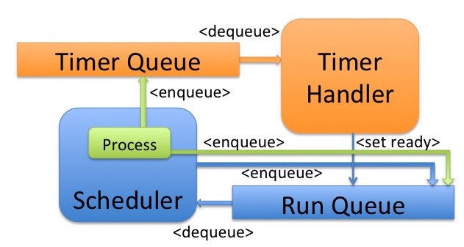
Timers and the Timer Queue

Slide 47
Timers
t.timeout(100);
t.start(100); setNotReady(); yield(1); label(1);
Becomes
t.start(100) will insert a new timer object into the TimerQueue.

Slide 48
Barriers
sync(b);
b.sync(this); yield(1); label(1);
Becomes
b.sync(this) will * decrement the barrier’s process counter * enqueue the process in the barrier’s process list * set itself not ready When counter reaches 0 all processes are set ready.

Slide 49
Alts
We probably do not have time for this… but they are cool.

Slide 50
Results
Timing
Context switching
Max process count
Overhead (we will skip this one too)

Slide 51
Timings and Context Switches
Mandelbrot fractal image 4,000 x 3,000
(12,000,000 pixels)
Version | Time (Sec.) | # Processes | # Context Switches
Java Sequential | 6.24 | 1 | 0
ProcessJ Sequential | 6.21 | 1 | 0
ProcessJ row parallel | 6.05 | 3,001 | 3,001
ProcessJ pixel parallel | 31.98 | 12,000,001 | 12,003,001

Slide 52
Context Switching Time
CommsTime
 | Mac / OS X |  |  | AMD / Linux
 | CPA’14 | JCSP | JVMCSP | CPA’14 | JCSP | JVMCSP
μs/iteration | 9.26 | 27.00 | 8.30 | 13.56 | 136.00 | 7.52
μs/communication | 2.31 | 6.00 | 2.08 | 3.90 | 35.00 | 1.88
μs/context switch | 1.32 | 3.00 | 0.69 | 1.94 | 17.00 | 0.63

Slide 53
Max Process Count
^{import std.strings;}
proc void foo(chan<int>.read c1r, ^{chan<int>.write c2w) {} ^{int x;}
^{par {}
^{x = c1r.read();}
^{c2w.write(10);}
} }
proc void bar(chan<int>.write c1w, ^{chan<int>.read c2r) {} ^{int y;}
^{par {}
^{y = c2r.read();}
^{c1w.write(20);}
} }
proc void main(string[] args) {
^{par for (int i=0;} ^{i<string2int(args[1]);} ^{i++) {}
^{chan<int> c1, c2;} ^{par {} ^{foo(c1.read, c2.write);}
^{bar(c1.write, c2.read);}
}
}
}
}
S
R
…
S
R

Slide 54
Max Process Count
# Processes | # Context Switches | Execution Time (Secs.) | Memory Usage (GB)
7,000,001 | 15,000,002 | 7.53 | 1.79
10,000,001 | 22,500,002 | 16.03 | 3.02
14,000,001 | 30,000,002 | 25.86 | 4.10

Slide 55
Max Process Count
# Processes | # Context Switches | Execution Time (Secs.) | Memory Usage (GB)
7,000,001 | 15,000,002 | 7.53 | 1.79
10,000,001 | 22,500,002 | 16.03 | 3.02
14,000,001 | 30,000,002 | 25.86 | 4.10
210,000,001 | 450,000,002 | 642.80 | 63.91
350,000,001 | 750,000,002 | 1,235.12 | 94.50
420,000,001 | 900,000,002 | 1,443.40 | 125.82

Slide 56
Max Process Count
# Processes | # Context Switches | Execution Time (Secs.) | Memory Usage (GB)
7,000,001 | 15,000,002 | 7.53 | 1.79
10,000,001 | 22,500,002 | 16.03 | 3.02
14,000,001 | 30,000,002 | 25.86 | 4.10
210,000,001 | 450,000,002 | 642.80 | 63.91
350,000,001 | 750,000,002 | 1,235.12 | 94.50
420,000,001 | 900,000,002 | 1,443.40 | 125.82
476,000,001 | 1,020,000,002 | 1,800.79 | 126.11
480,900,001 | 1,030,500,002 | 1,801.40 | 126.20

Slide 57
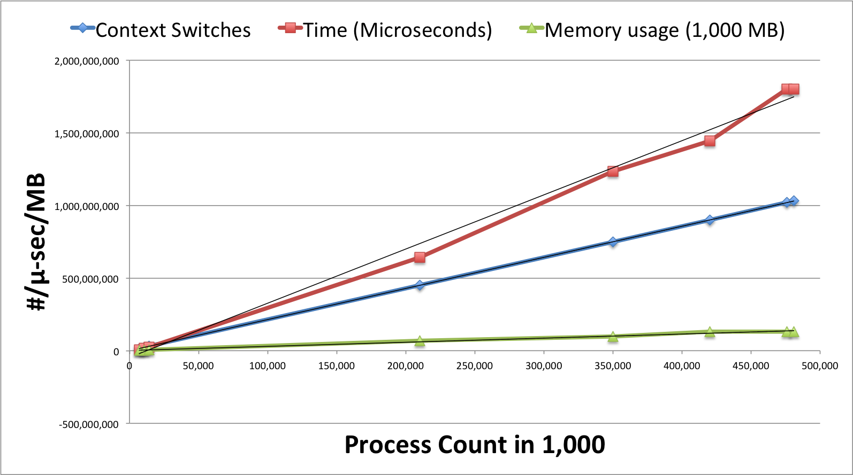
Max Process Count

Slide 58
Conclusion
ProcessJ code generator that produces Java source.
JVMCSP runtime implemented.
ASM bytecode instrumentation.
Performs better than CPA’14 and JCSP.
Can handle approximately half a billion processes in 128GB.

Slide 59
Future Work
Multi-core Scheduler
Network distribution
Libraries
Mobile processes
Alts & claims are `busy waits’ (remain ready to run and cycle through the run queue)
More back ends

Slide 60
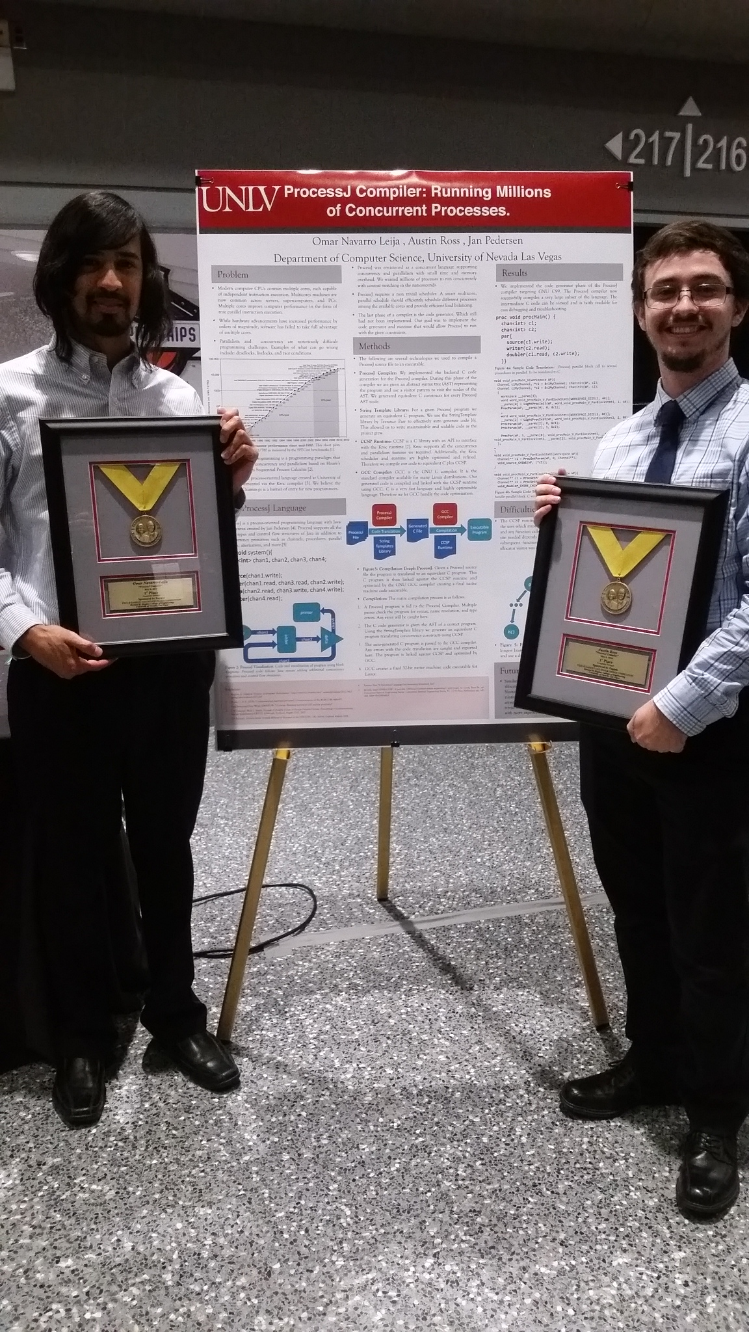
Other Back Ends
Omar and Austin won gold in the UNLV College of Engineering Senior Design Competition for a CCSP code generator for ProcessJ

